Slide 1
TPI New Teacher Workshop: Differentiating for Learning
Welcome!

Slide 2
Teacher Preparation Initiative (TPI): St. Cloud State University and Six Partner Districts: Holdingford, Monticello, ROCORI, St. Cloud Area, Sartell-St. Stephen & Sauk Rapids-Rice

Slide 3
New Teachers and Induction Leaders from: Annandale, Holdingford, Monticello, ROCORI, St. Cloud Area, Sartell-St. Stephen, Sauk Rapids-Rice, Lionsgate Academy, & West Education Center St. Cloud State University Faculty and Staff

Slide 4
What is the Teacher Preparation Initiative (TPI)?
TPI is a grant funded by the Bush Foundation
The funding is used to reform the way we recruit, prepare, employ and support teachers-also considering technology and assessment
There are 14 higher education institutions doing this work and all are funded by the Bush Foundation. For more information, visit nextteacher.org
All the reform work that is done is in partnership with our P-12 Partners in the six districts
You are here as part of support for all SCSU Graduates in Teacher Education and all new teachers in our six Partner Districts
For more information, visit stcloudstate.edu/tpi

Slide 5
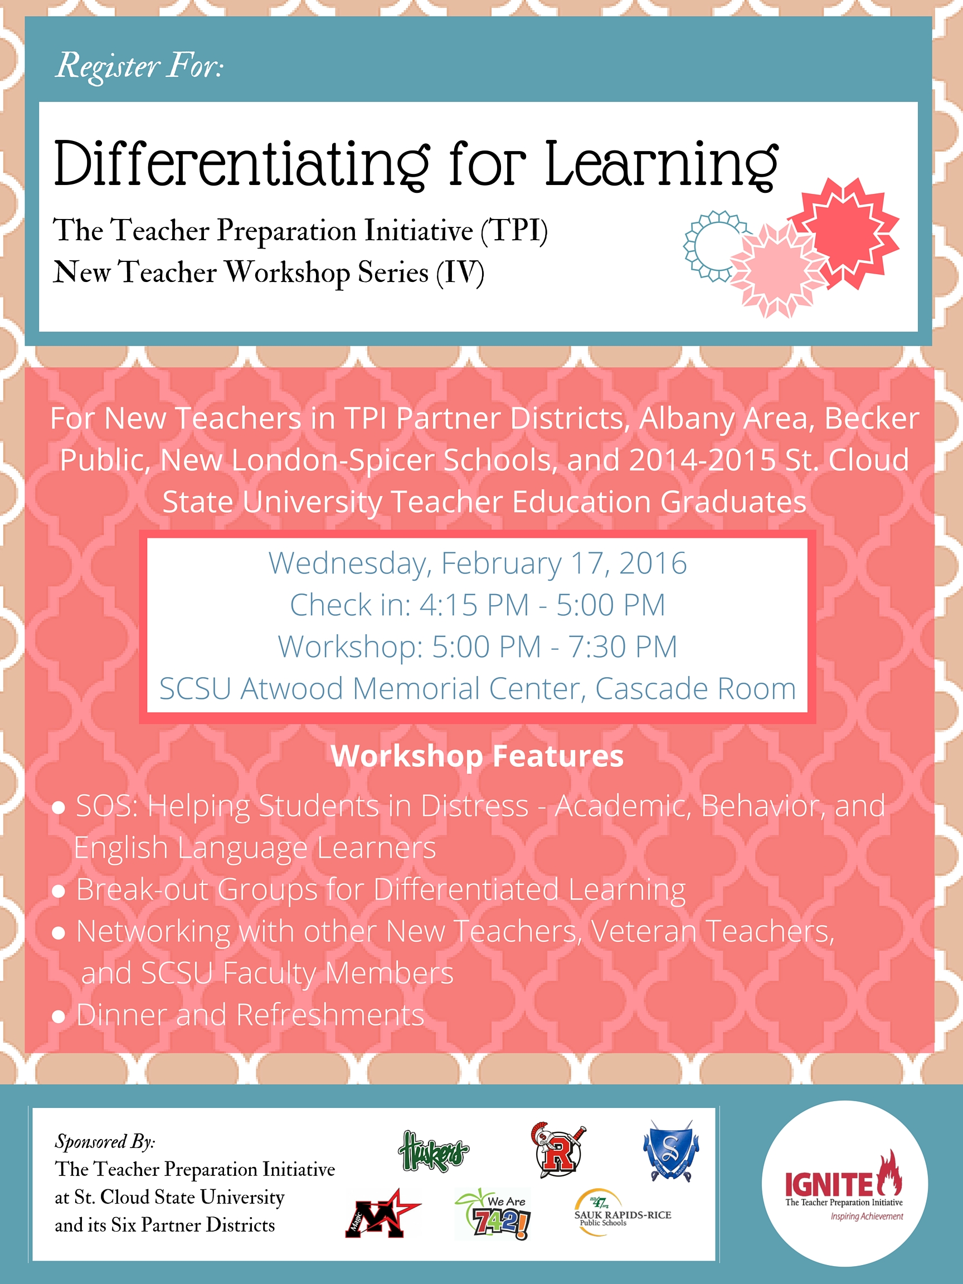

Slide 6
Check out our website specifically for new teachers: tpiscsu1.weebly.com Resources from today’s workshop are and will be uploaded for you to access.

Slide 7
Start following us on Twitter @TeacherPrepIn and join in our conversations at #TPIntw

Slide 8
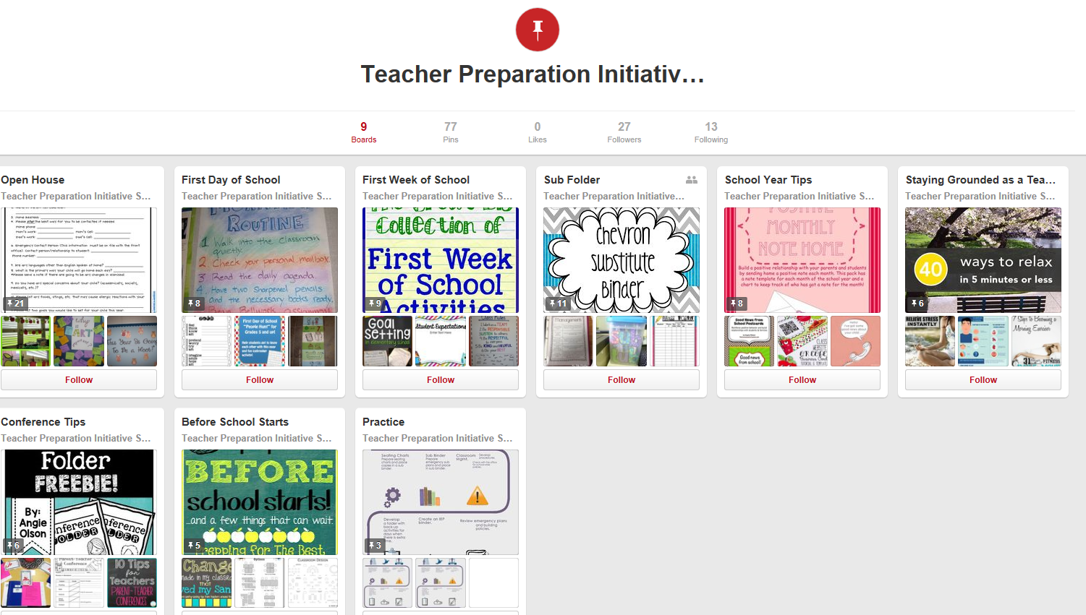
Have you heard about our Toolkit for New Teachers? Find it on Pinterest at: pinterest.com/scsut

Slide 9
Feeling low or disillusioned?
Sign up for a free resource: The New Teacher Disillusionment Power Pack!
What is it? The Power Pack is a one-month series of emails to help new teachers get through the hardest part of their first year.
Read more about the Power Pack at: http://tinyurl.com/nd74sl9
Sign up at: http://tinyurl.com/ow3gun9

Slide 10
Follow the Teacher Preparation Initiative! Website: stcloudstate.edu/tpi Blog: tpiscsu.blogspot.com Facebook: facebook.com/tpi.ignite

Slide 11
TPI offers five New Teacher Workshops every year. The dates for 2015-16 include: Tuesday, August 4 (all day) Wednesday, October 28 (evening) Wednesday, December 9 (evening) Wednesday, February 17 (evening) Wednesday, April 20 (evening) These workshops will start your networking with new teachers across the partnership and recent SCSU Graduates. You will also have opportunities to work with veteran P-12 teachers and SCSU Teacher Education Faculty Members. We invite you take advantage of these collaborative days of learning, networking, and socializing!

Slide 12
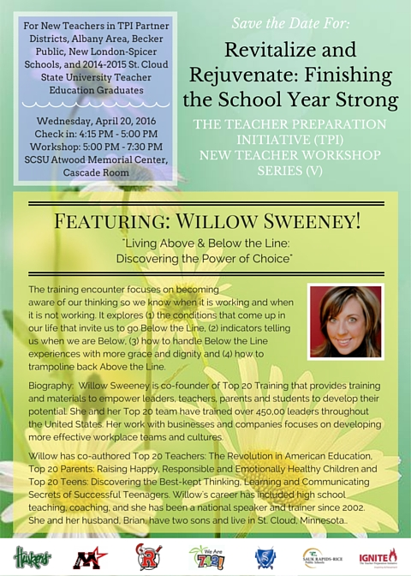
Save the date! April 20 is the final TPI New Teacher Workshop of the 2015-16 Academic Year!

Slide 13
Planning of the February 17th Workshop includes representatives from Partner Districts and SCSU:
Holdingford Milissa Walz and Katie Young
Monticello Lori Hanson
ROCORI Jennifer Christoffersen
St.Cloud Area Kirsten Rude
Sartell-St.Stephen Peggi Fogarty
Sauk Rapids-Rice Megan Rogholt
St. Cloud State University Beth Mann, Mark Minger, Ming-Chi Own, and Patty Waletzko

